Slide 1
Physical Security Controls

Slide 2
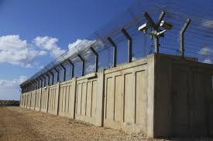
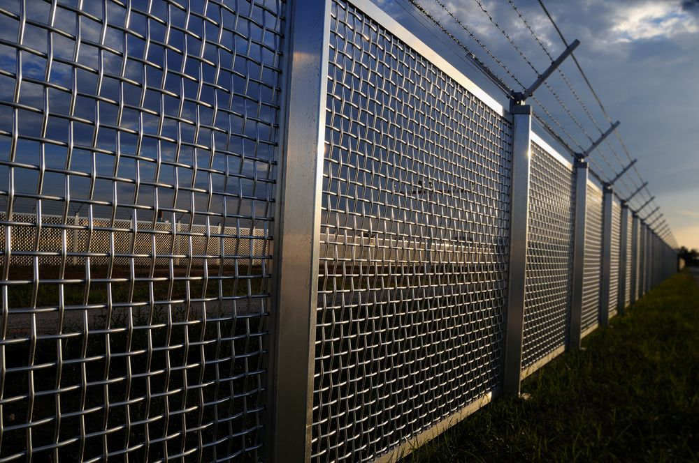
Fences
Define perimeter
Clearly defined limits
Can be uninviting (good and bad)
Different types of fencing
Opaque
Transparent
Difficult to break through
Prevent climbing
Meant to slow ingress/egress, not 100% prevent

Slide 3
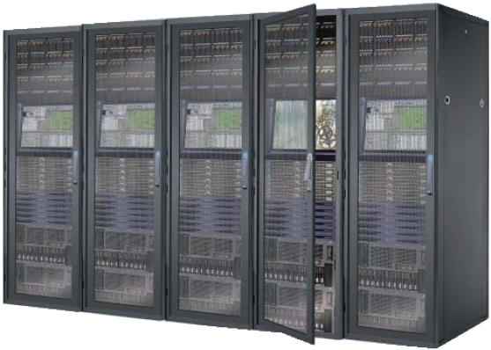
Rack monitoring and security
Monitoring systems in data centers
Environmental monitoring
CCTV cameras
Enterprise monitoring system
Security
Closed gates/doors on racks
Locked
Fences/cages and gates
Protect physical access to servers and racks

Slide 4

Guards and Access lists
Security guard
Provides physical presence
Deterrent
Validates employee IDs
Provides guest access
ID badges
Picture, name, role
Must always be worn (visible)
Access list
Typed, physical list of names
Enforced by security guard

Slide 5
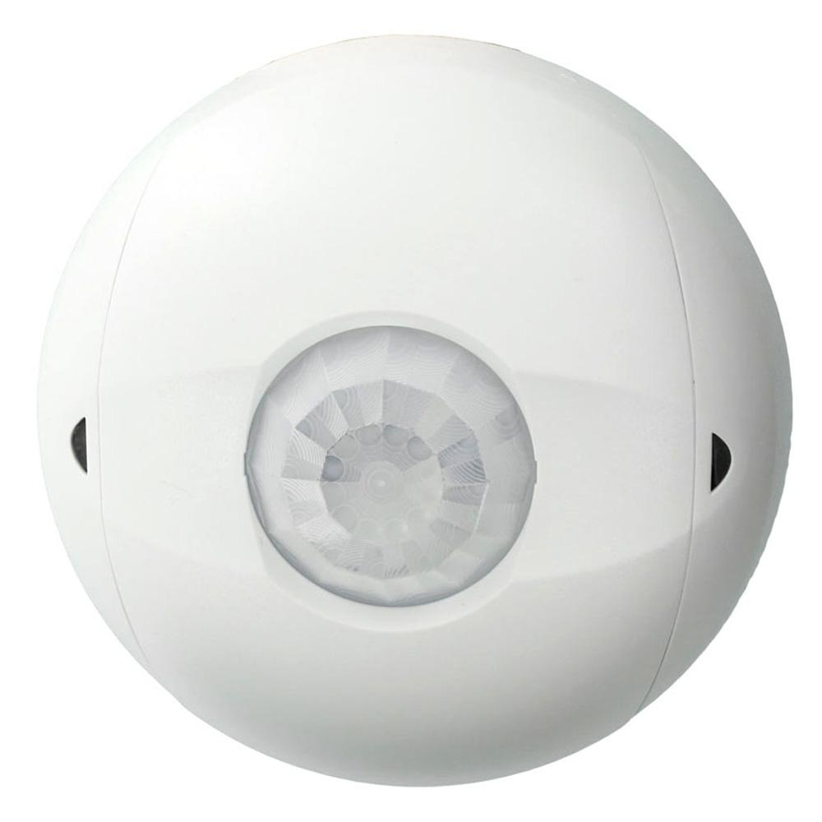
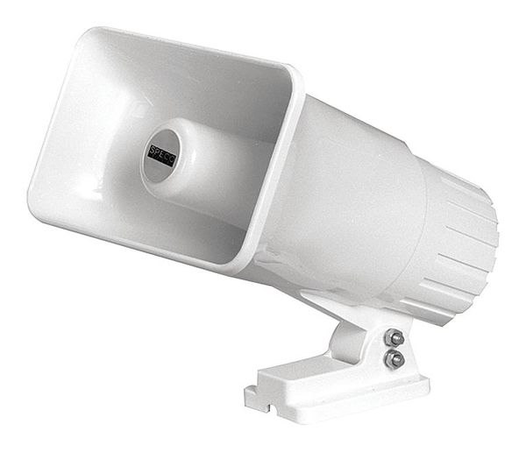
Alarms
Circuit-based
Doors, windows, fence/gates
Useful on perimeter
Motion detection
Passive IR (heat)
RF reflection (similar to radar/sonar)
Ground vibration (outdoor, fenced area)
Useful in areas not typically used by staff

Slide 6
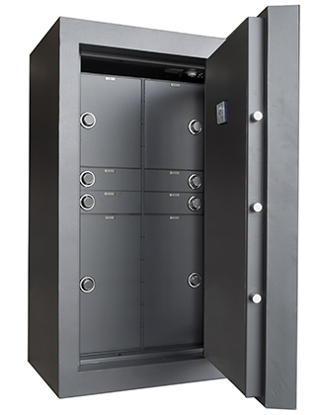
Safe
Secure important hardware and media
Protection from damage
Fire, water
Difficult to steal
Heavy
Bolted in
Must be managed diligently
Do not share combination
What happens when combination is lost?

Slide 7
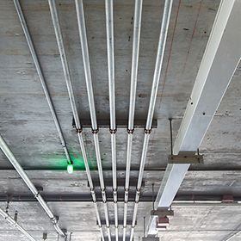
Protected distribution
Protected Distribution System
Physically secure network cabling
Protects cable and fibers
Prevents cable and fiber taps
Direct taps (copper/fiber)
Inductive taps (copper)
Prevents cable/fiber cuts
A physical Denial of Service
Sealed metal conduit, periodic visual inspection

Slide 8

Air gap
Physical separation between networks
Secure network and insecure network (SIPRnet/NIPRnet)
Completely separate infrastructures
Not just segmented - physically separated
Standard networks use shared hardware
Shared routers, switches, firewalls
Air gap has dedicated hardware
Special networks with air gaps
Stock market networks
Power systems/SCADA
Airplanes

Slide 9
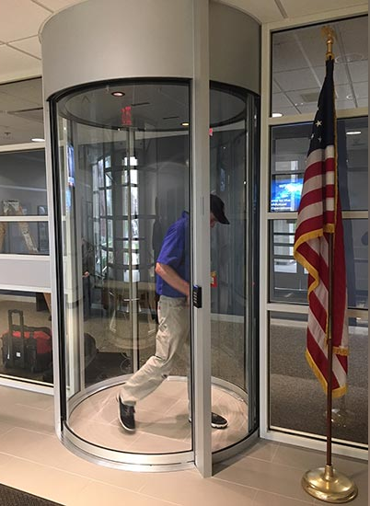
Mantraps
One person at a time
Prevents tailgating/coat-tailing
Normally locked
Unlocking one prevents others from unlocking
Normally unlocked
Opening one door causes others to lock
Some data centers have weight sensors to ensure no hardware is carried out!
Airport exits usually have this
“Exit only”, “No reentry”

Slide 10
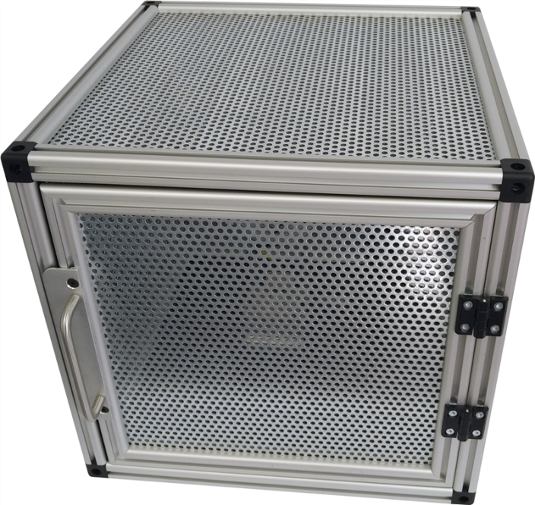
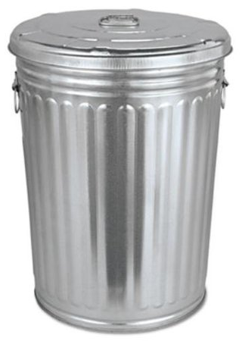
Faraday cage
Blocks radio signals
Enclosure of conductive material
Can be actual cage, mesh (metal screen), or solid (aluminum foil/metal locker)
Prevents RF from entering/escaping
Greatly attenuates signal
Window of microwave oven is a Faraday cage
Not total solution
Not all signals are blocked 100%, only attenuated

Slide 11
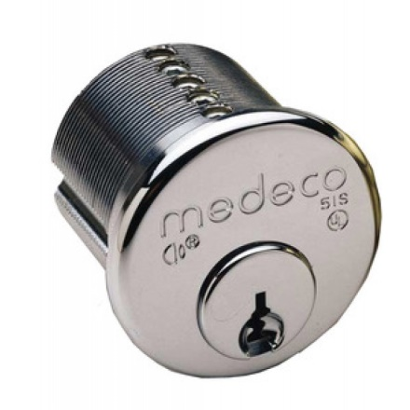
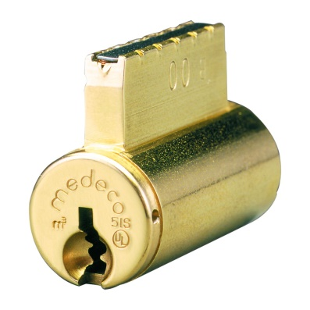
Door access controls
Conventional locks
Lock and key
Deadbolt
Physical bolt into door frame
ANSI Grades
Grade 3 – Basic Security. Used for light security residential needs
Grade 2 – Medium Security. Used in commercial (apartments, businesses)
Grade 1 – High Security. Used in schools, banks, hospitals
Locks can only slow a determined physical attacker
10-15 minutes is “military grade” (Medeco Locks) [src: Wired]

Slide 12
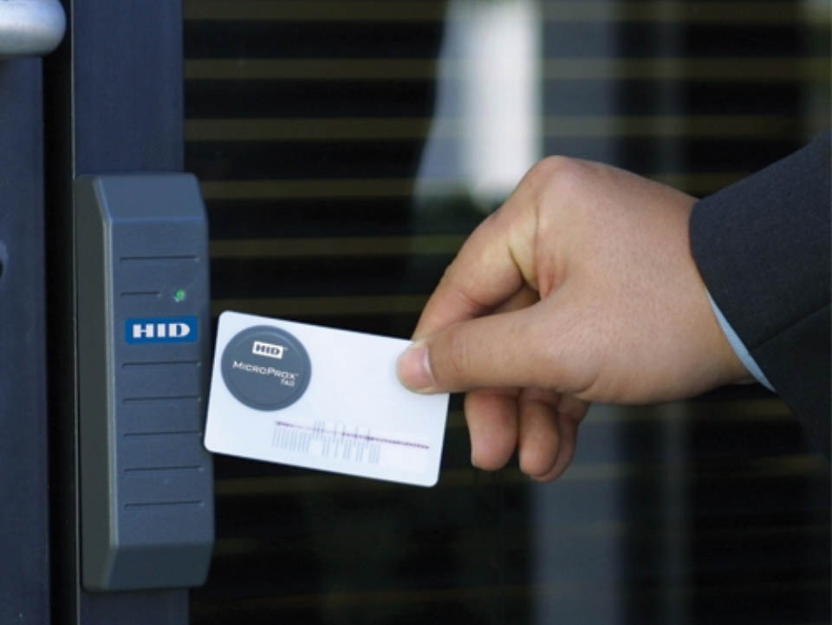
Door access controls
Electronic locks
No physical key
Combination/PIN
Biometric
Token-based locks
Magnetic swipe
RFID/proximity card reader
Multifactor
ProxCard and PIN

Slide 13
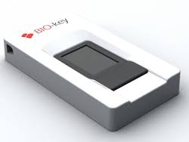
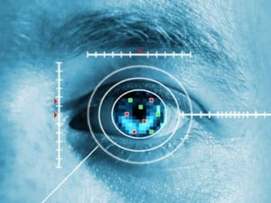
Biometrics
Biometric authentication
Fingerprint, Iris and retinal scans
Numeric representation of your input
Picture of fingerprint isn’t usually saved, just coordinates
Same with iris pattern, retina pattern
Difficult to change
Can change a password, Can’t change your fingerprint (comfortably)
Used in very secure environments
Can be slower than other methods
Not 100% foolproof (nothing ever is)

Slide 14
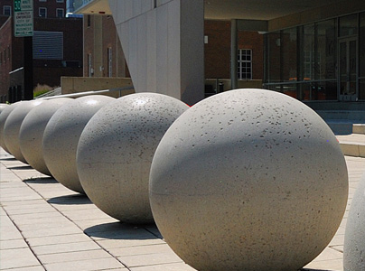
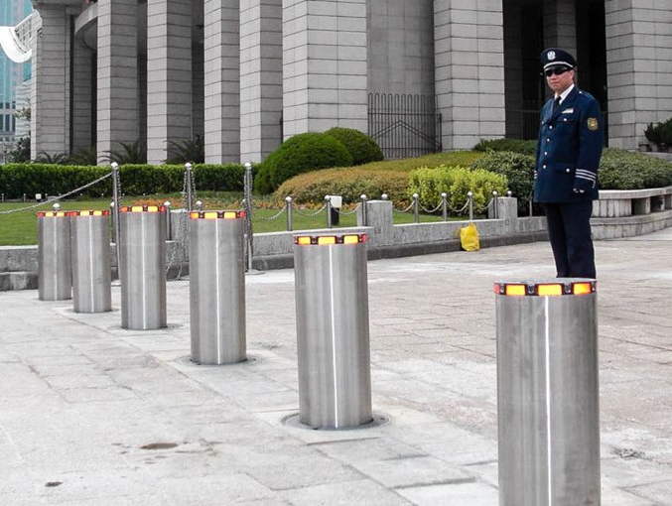
Barricades / bollards
Prevent access
There are limits to the prevention
Channel people to specific entries
Allow people, prevent vehicles
See them at malls, stores
Safety concerns
Extreme examples
Concrete barriers/bollards
Moats
Gravel pits

Slide 15
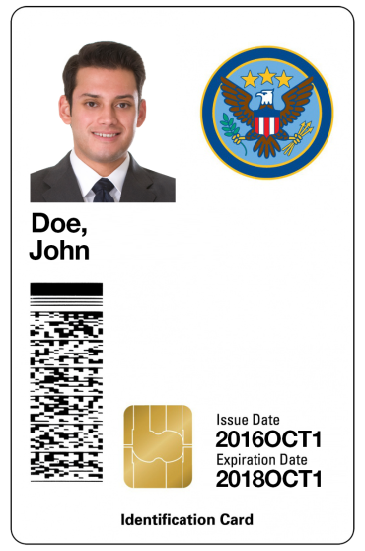
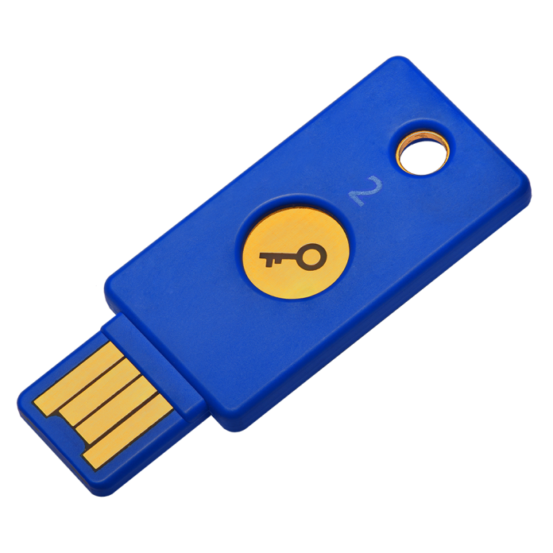
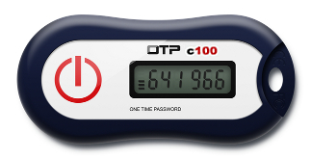
Tokens and cards
Smart card
Computer based readers
May also require PIN (2FA)
USB token
Digital certificate on USB device
Hardware or software tokens
Generates codes for one-time use
Increasingly, cell phones
SMS a code to your phone for one-time use

Slide 16
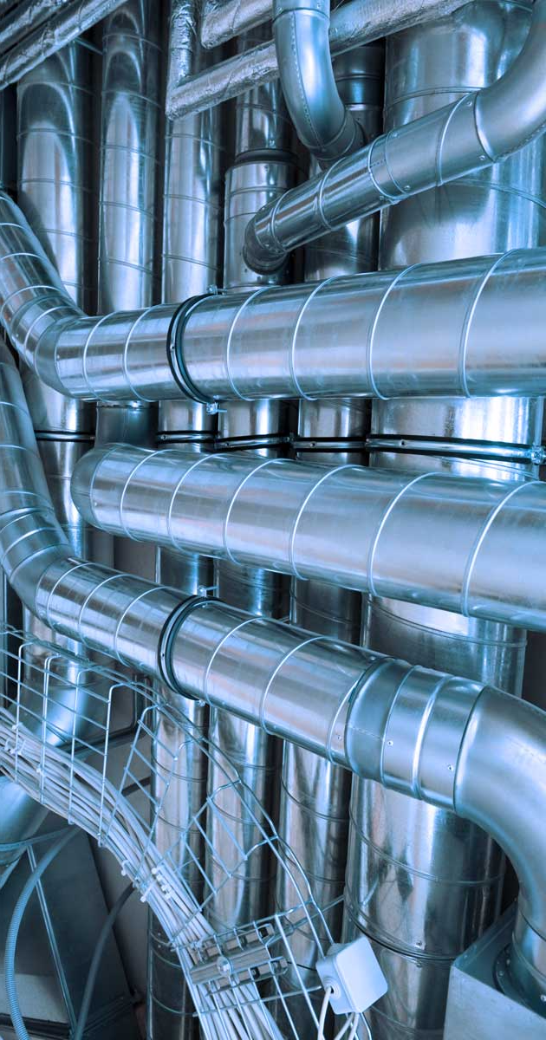
HVAC
Heating, Ventilating, and Air Conditioning
A complex science
Not something to attempt on your own
Fire system integration
Don’t want to circulate smoke!
Separate data center HVAC than office workplaces
Overheating is key concern
Data center kept much colder
Closed-loop air recirculation, Positive pressurization
Recycles internal air, air is pushed outward

Slide 17
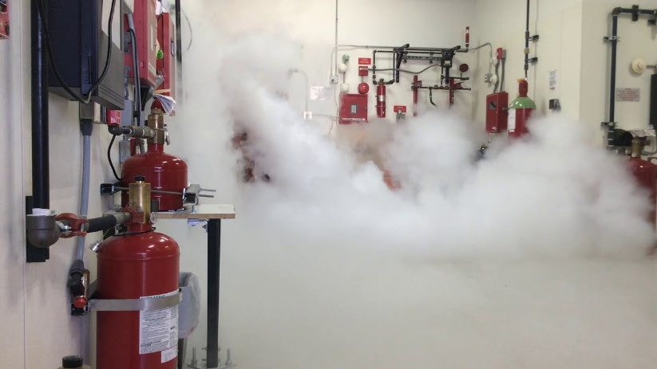
Fire suppression
Traditional fire fighting systems use water
This is not a good thing around electronics!
Suppress with chemicals in data centers
HFC-227ea
(Also used in asthma inhalers)
Halon (old, no longer used)
Bad for environment
Foam (messy, leaves residue)

Slide 18
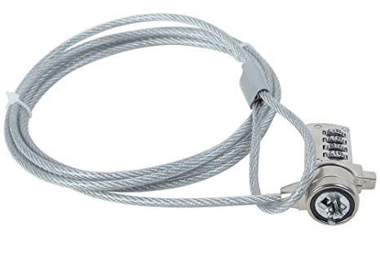
Cable locks
Temporary, mobile security
Binds mobile device to something solid
Cable works almost anywhere
Hotel, Remote office, etc.
Standard connector
Officially the Kensington Security Slot
Developed in early 1990s
Found on most mobile devices
Reinforced notch
Not intended for long-term, high-impact protection
Cable can be easily cut by determined adversary

Slide 19
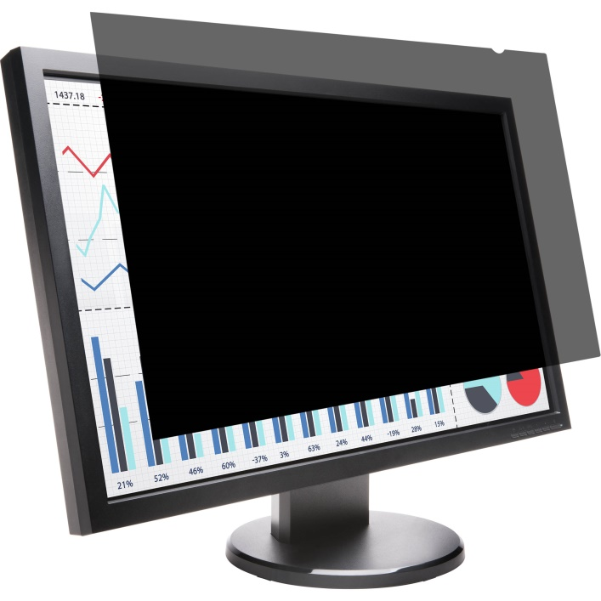
Screen filters
Control your input
Hand movements can give away weak passwords
Be aware of your surroundings
Who is behind you? Can someone “shoulder surf”?
Keep monitor aimed away from windows and doors

Slide 20
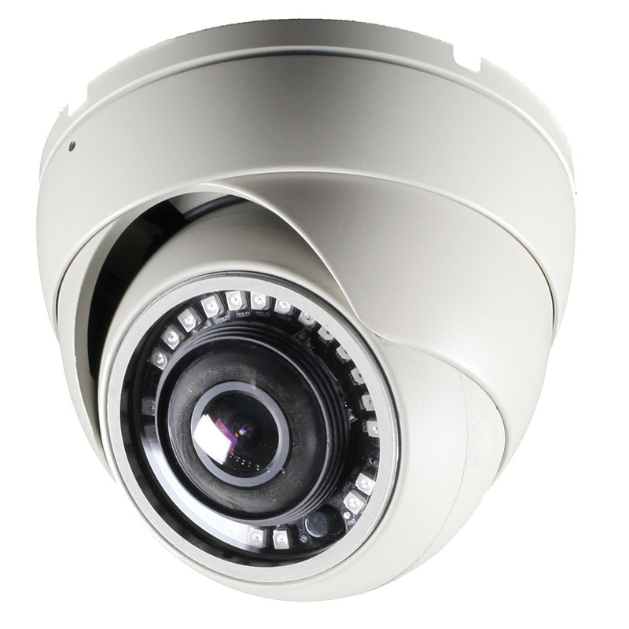
Video surveillance
CCTV (Closed Circuit television)
Can replace physical guards
Increase guard efficiency
Camera properties are important
Focal length
Depth of field
Lighting requirements
night vision?
Often part of a networked system
Multiple cameras, overlapping coverage
Prevent attacker from obscuring a single camera’s view
Recorded and stored for long periods

Slide 21
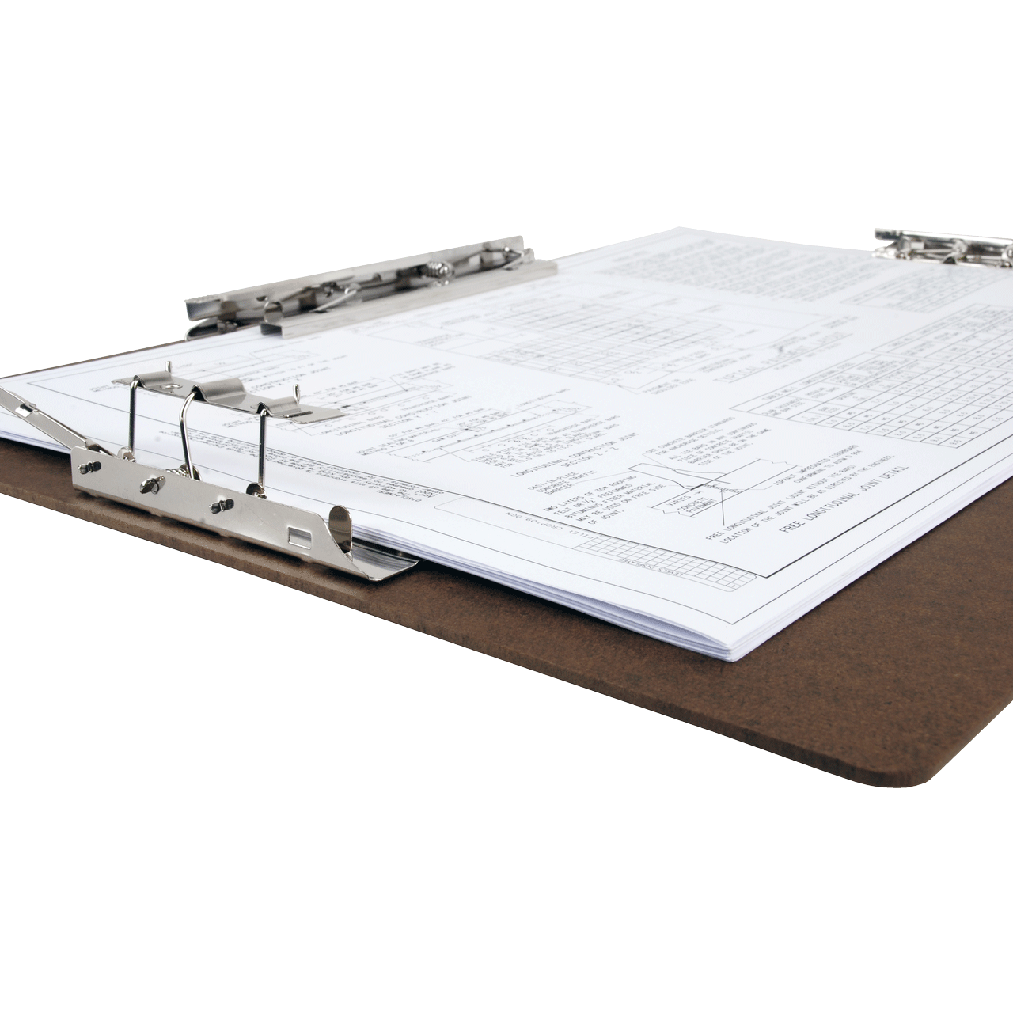
Logs
Everything gets logged
Parking facility entering/leaving
Identification upon entering/leaving the building
Badge assignment tracks coming/going from rooms
Correlate physical location with digital access
Someone logged into the console while in the this room
Formal process is needed to collect and store log info
Logs can be both physical and digital
Privacy laws may apply
What local laws/regulation if any apply? Industry regulations?

Slide 22
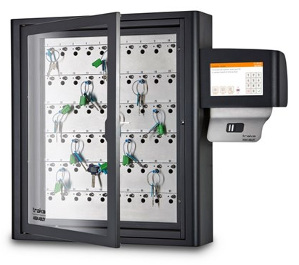
Key management
Control physical access
Keys can be physical or digital
Protect access
Key generation
Process to generate keys for access
Master keys only held by those that need access to all doors
Create oversight to this access
Key breaches
Unauthorized use – who has it? Why?
What happens when a key is compromised?

